Slide 1
IFC
Régis Longchamp
ENAC-IT4R
10.06.2022

Slide 2
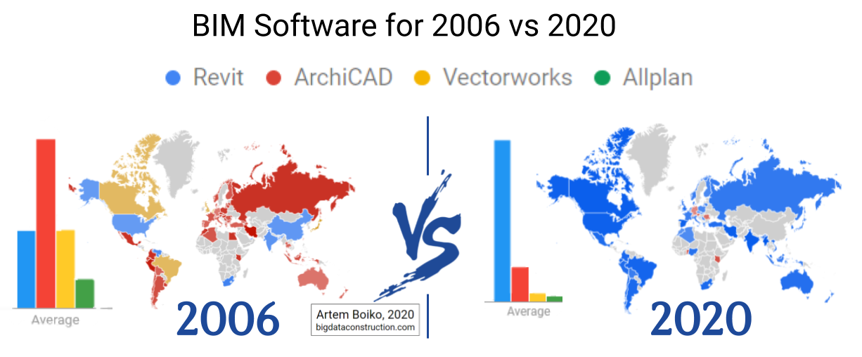
Revit and the others …

Slide 3

Pourquoi IFC ?

Slide 4
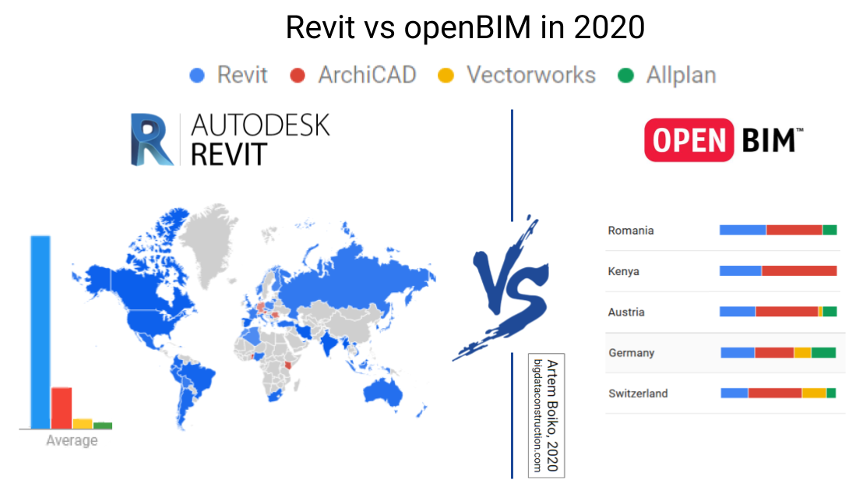
Revit and the others …

Slide 5
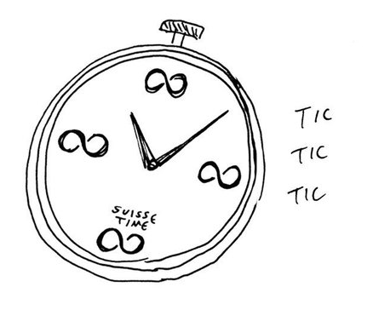
Revit and the others …
A Travail préparatoire
B Projet & réalisation
C Exploitation
Modèle de
base
Modèle
d’information pour
la phase projet
Modèle d’information pour la phase d’expoitation
Process mandant
Process mandataire
Process gestionaire
Source: FHNW selon SIA 2051

Slide 6
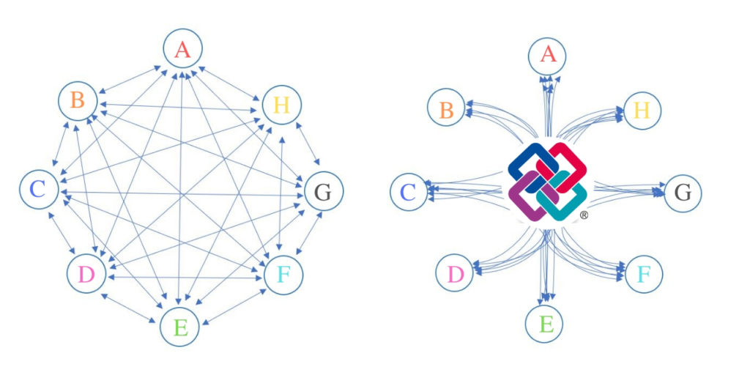
IFC

Slide 7
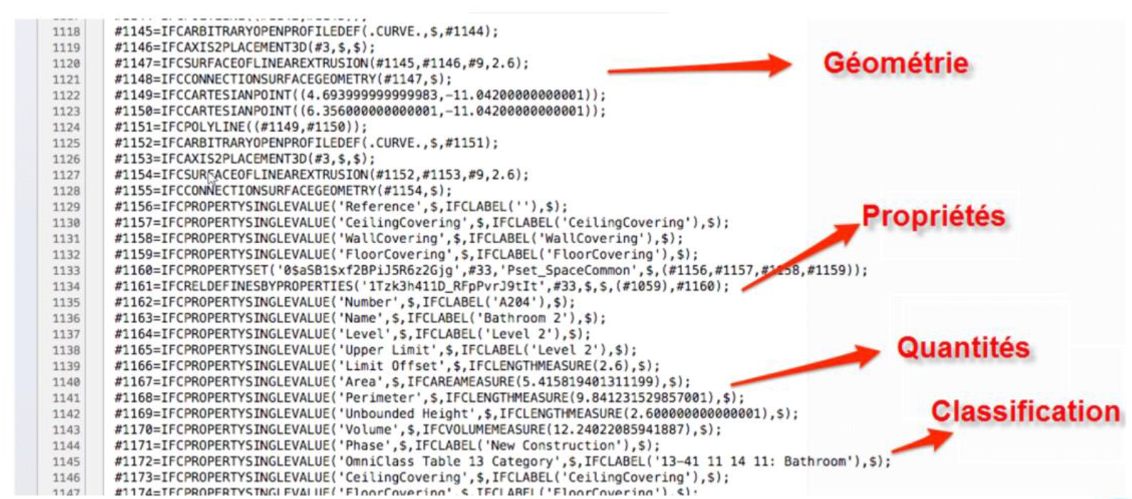
IFC

Slide 8
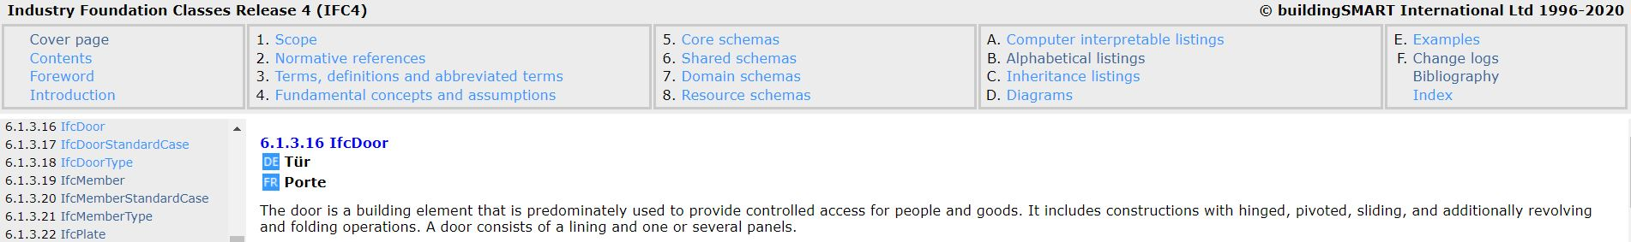
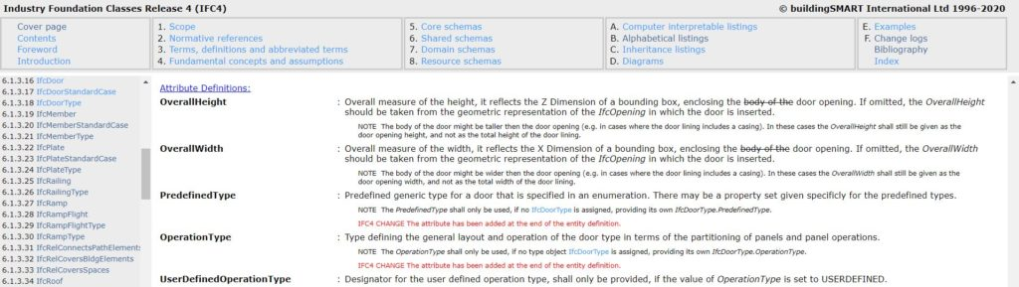
IFC
IFC is a neutral, open format for data exchange
IFC describes each element as a class.
Notes:
https://standards.buildingsmart.org/IFC/RELEASE/IFC4/FINAL/HTML/link/ifcdoor.htm

Slide 9
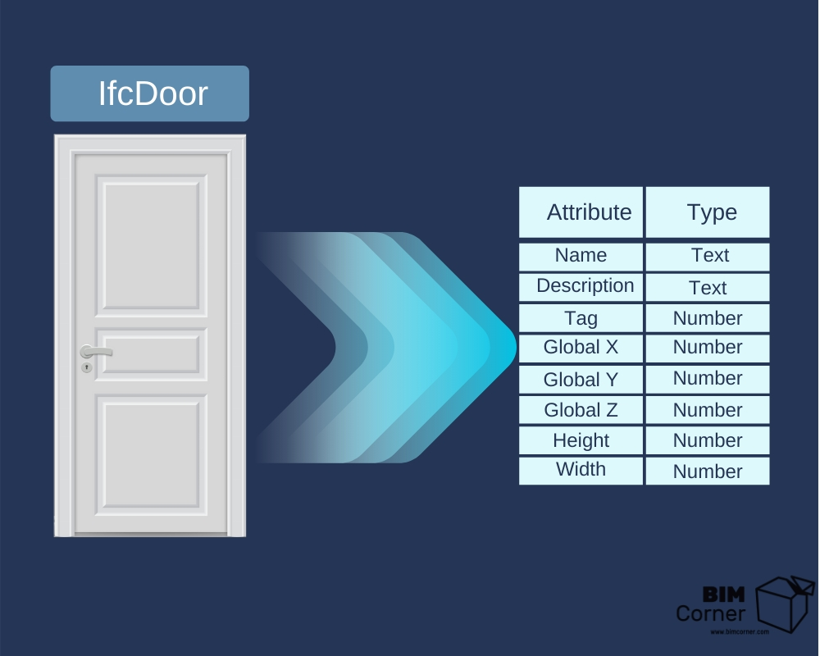
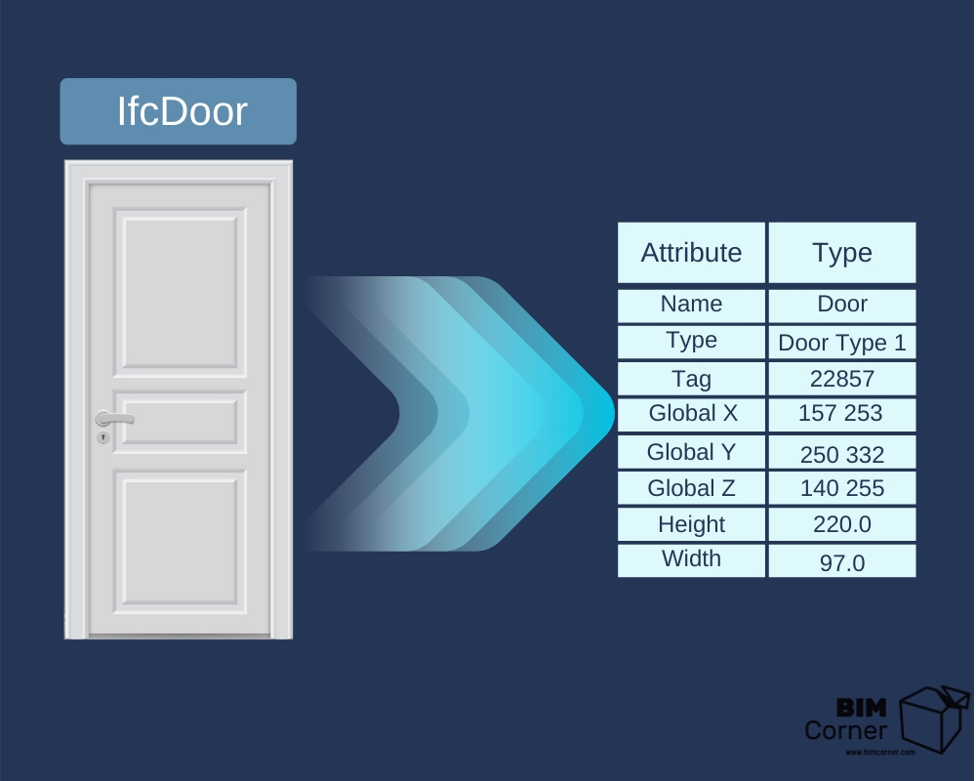
IFC
This type of object description gives us confidence that regardless of which program we will use to generate the IFC model, the object attributes will always be in the same format, therefore “Name” will always be a text, and “Height” will always be a number.

Slide 10
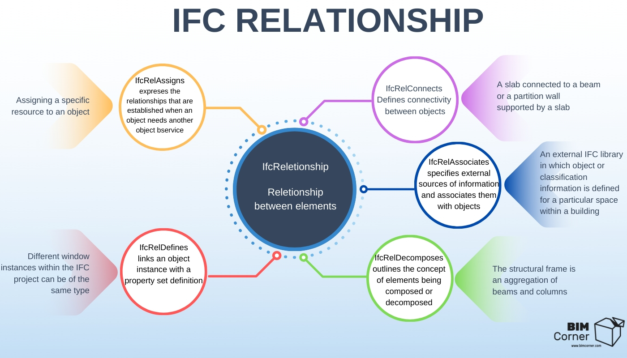
IFC
The IFC schema also has more abstract classes, such as “relationships”, which describe the way of connecting objects with the use of attributes.
Notes:
https://standards.buildingsmart.org/IFC/DEV/IFC4_3/RC2/HTML/schema/ifckernel/lexical/ifcrelationship.htm
IFCRELCONTAINEDINSPATIALSTRUCTURE
IFCRELDEFINESBYPROPERTIES
IFCREL

Slide 11
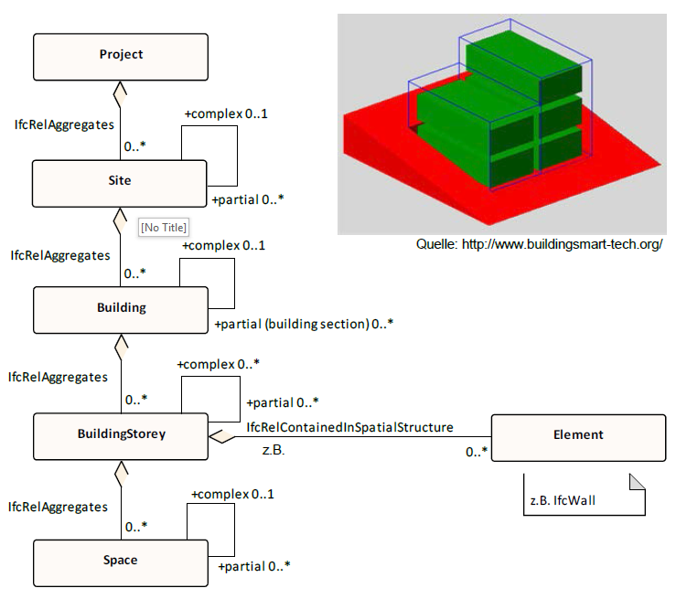
IFC
Notes:
https://standards.buildingsmart.org/IFC/DEV/IFC4_3/RC2/HTML/schema/ifckernel/lexical/ifcrelationship.htm
IFCRELCONTAINEDINSPATIALSTRUCTURE
IFCRELDEFINESBYPROPERTIES
IFCREL

Slide 12
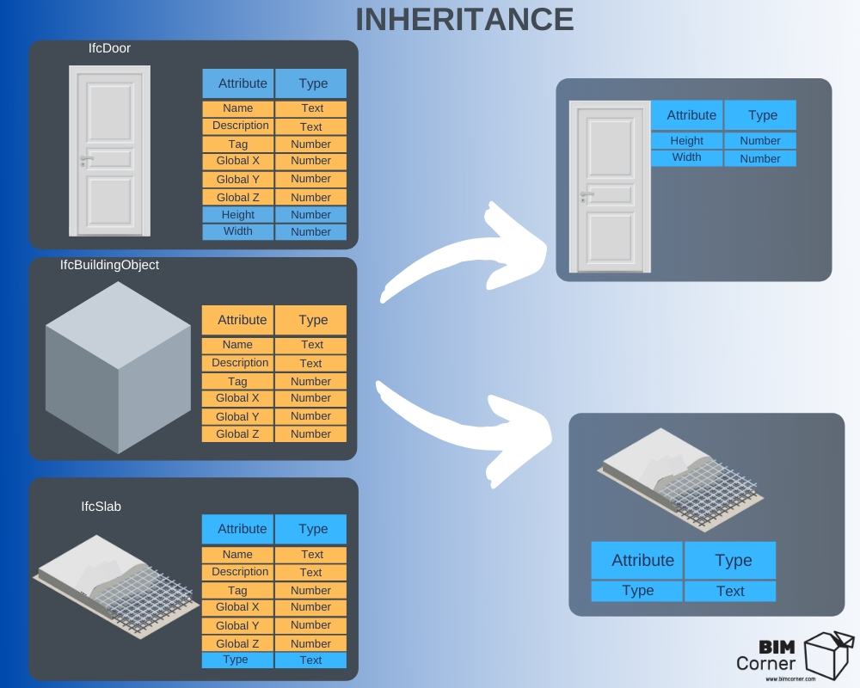
IFC

Slide 13
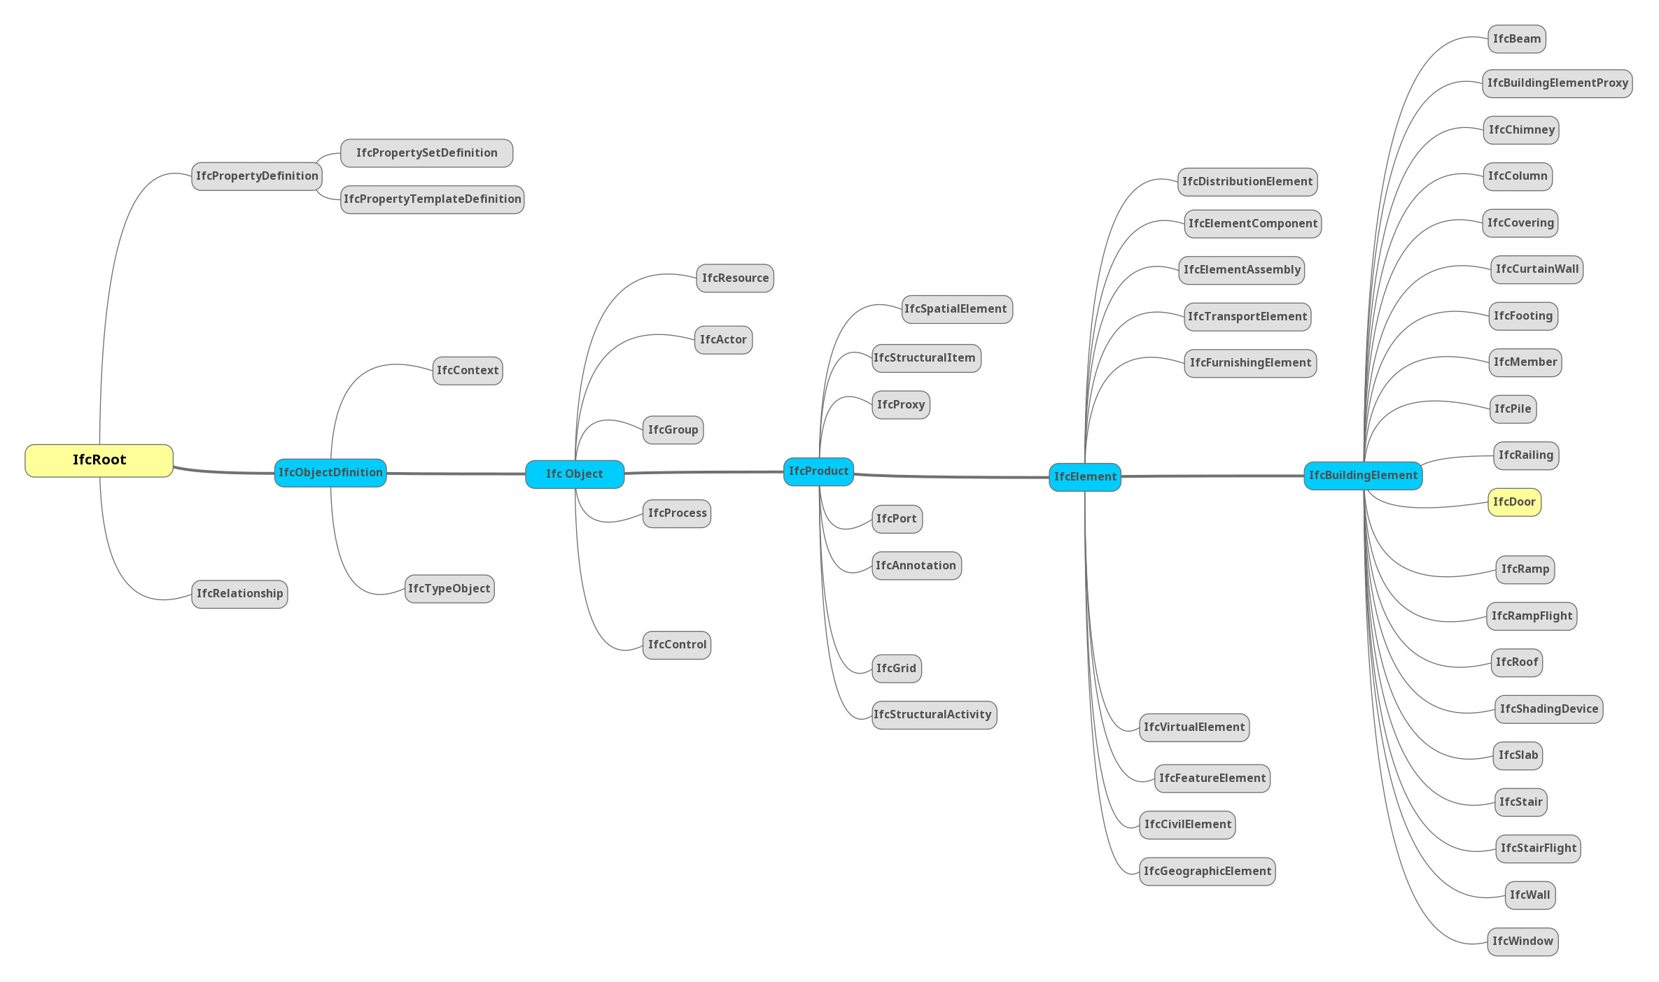
IFC

Slide 14
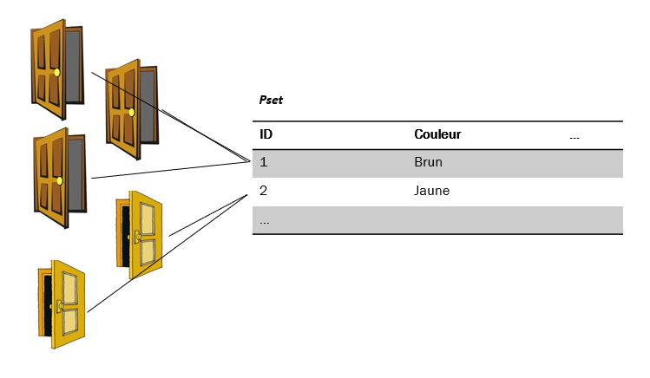
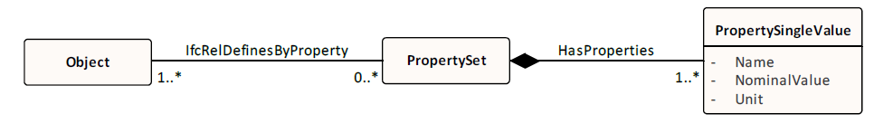
IFC - Attributes vs. Properties
Attributes (the number and the value type are part of the IFC object template – a graphic from the previous post). These attributes form an integral part of the schema. You cannot delete or modify them. Removing an attribute from the schema will simply ruin its structure, and it will be impossible to open the IFC file.
Properties, as opposed to attributes, give us the freedom to create. We decide how many and what type of properties we wish to create and assign to an object. They are not included in the schema, hence if they are modified or deleted, the structure of the schema is not damaged.

Slide 15
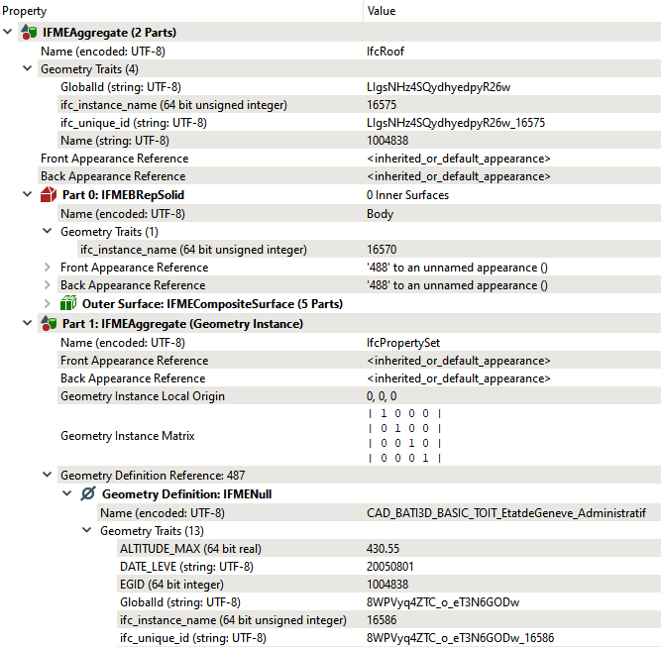
IFC – Tous est relation
géométrie
Attribut (en termes SIG), propriétés (en termes IFC)

